Slide 1
EF Core Fundamentals
Ishaan Malik

Slide 2
Entity Framework Core (EF Core)
EF Core is a lightweight, extensible, open-source, and cross-platform version of Microsoft's popular Entity Framework data access technology.
It serves as an Object-Relational Mapper (ORM), which allows .NET developers to interact with relational and non-relational databases using strongly-typed C# objects instead of writing manual data-access code or raw SQL queries.

Slide 3
Key Features & Benefits of EF Core
LINQ Queries: Write type-safe database queries natively in C# via Language Integrated Query (LINQ), which EF Core automatically translates to the appropriate SQL dialect.
Change Tracking: Automatically keeps track of the modifications made to your C# memory entities and handles the complexity of executing SQL INSERT, UPDATE, or DELETE statements when saving.
Database Migrations: Allows developers to incrementally evolve the database schema directly from C# code changes using simple commands like add-migration and update-database.
Cross-Platform & Lightweight: Works seamlessly across Windows, Linux, and macOS with a significantly lower memory footprint compared to legacy EF6.
Broad Database Support: Connects to many database systems via pluggable NuGet providers, including Microsoft SQL Server, SQLite, MySQL, PostgreSQL, Oracle, and Azure Cosmos DB.

Slide 4
Object-Relational Mapper (ORM)
An ORM acts as a bridge between two completely different programming paradigms: the object-oriented design of your application code (like C# or Java classes) and the relational structure of a SQL database (tables, rows, and columns).
Without an ORM, developers must write repetitive "plumbing" code to map database columns into objects manually, which increases development time and code complexity.

Slide 5
ORM Advantages & Disadvantages
Advantages | Disadvantages
Less code, fewer typing mistakes | Hides the SQL – you must still learn what it generates
Pre-built IntelliSense, Type safety, and boilerplate available | Can be slower than hand-tuned SQL for very special queries
Protects against SQL injection by using parameters automatically | Beginners may accidentally load too much data
Same code can talk to different databases | Another thing to learn

Slide 6
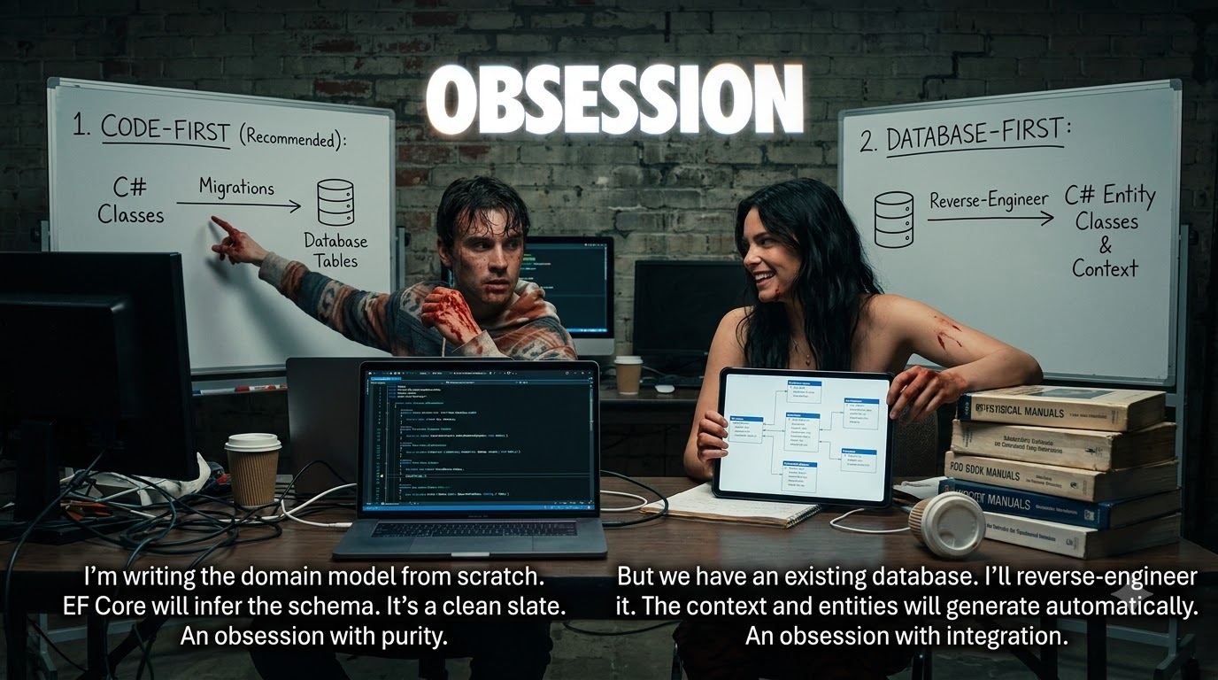

Slide 7
DbContext and DbSet
DbContext and DbSet classes are the two primary building blocks used to interact with your database.
A DbContext represents your entire database session, acting as a bridge for querying and saving data. A DbSet<T> represents a specific table within that database, where T is the C# entity class mapping to the table's rows.

Slide 8
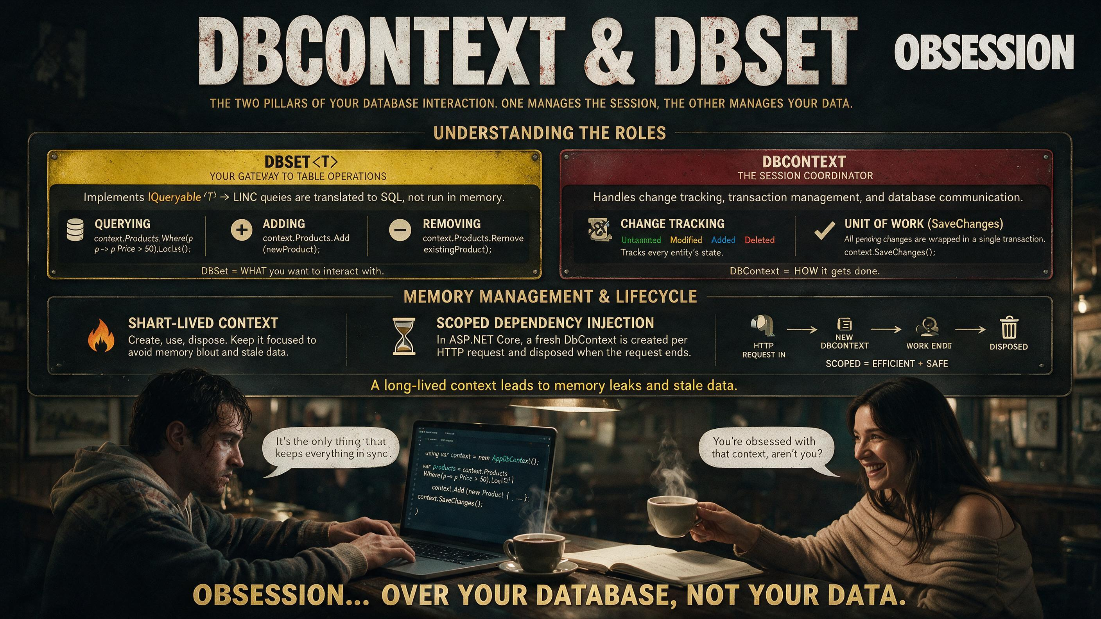

Slide 9
Entities, Keys, Conventions
An entity is a plain C# class that EF Core maps to a database table.
  Each property becomes a column and each object becomes a row.
A key is the property that uniquely identifies each row.
Conventions are EF Core's built-in naming rules that set these up for you.
  Conventions are default rules EF Core uses to build the model from your classes.

Slide 10
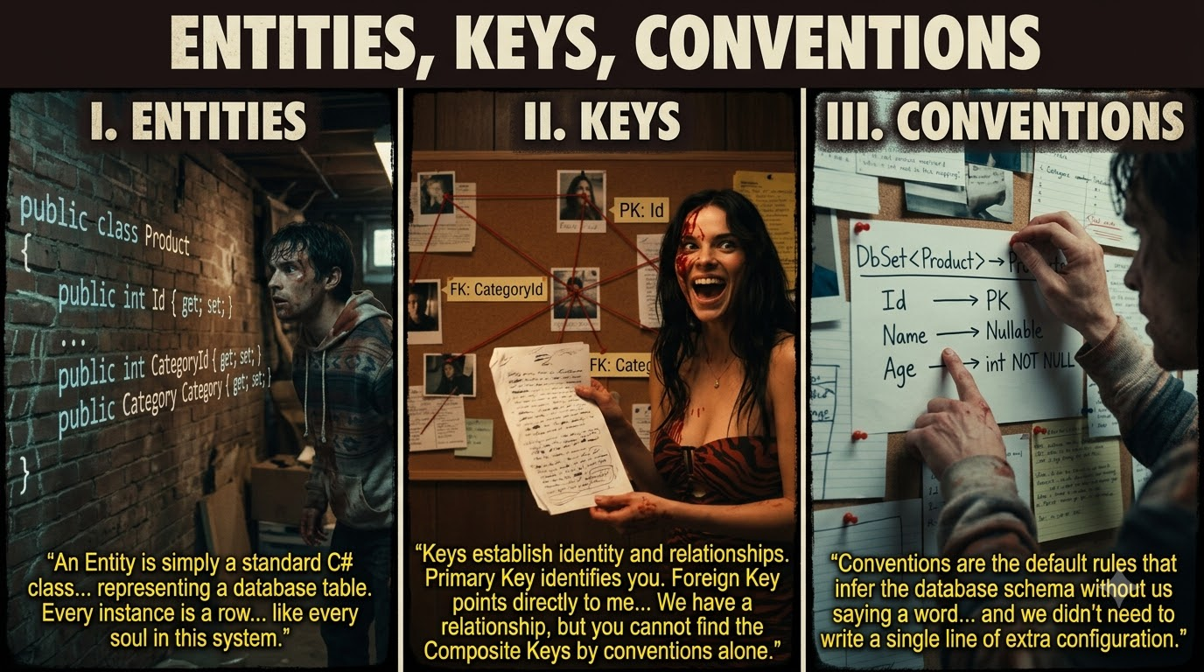

Slide 11
Database Migrations
Migrations are the standard way to incrementally evolve your database schema as your C# data model changes.
Instead of manually writing SQL DDL scripts (CREATE TABLE, ALTER COLUMN), you modify your C# entities, and EF Core handles generating the precise delta scripts to update the database.
When you change your model, EF Core compares it with a stored snapshot of the old model and generates a migration file for the difference.

Slide 12
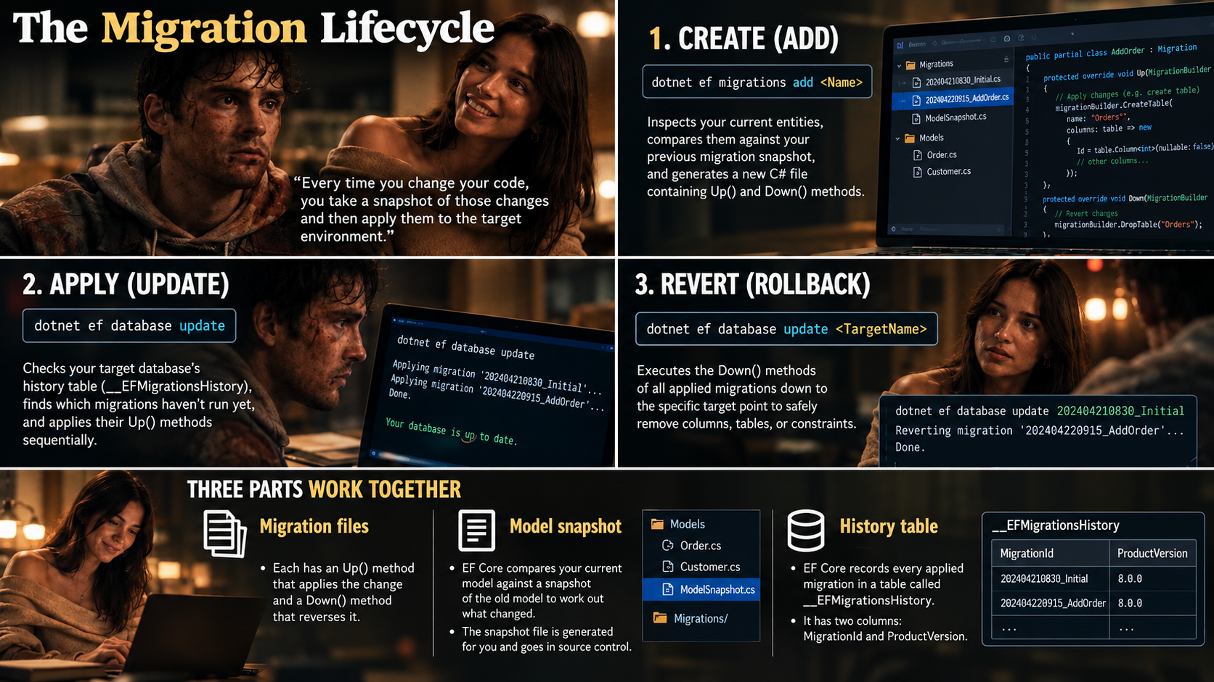

Slide 13
Tracking vs AsNoTracking
Tracking means EF Core keeps a record of each loaded entity in its change tracker.
  Any change you make is saved to the database when you call SaveChanges.
  By default, queries that return entities are tracking queries.
No-tracking queries skip the change-tracking setup, so they are generally quicker.
  Use them when you don't need to update the entities (Select queries).
var product = await _db.Products.FirstAsync(p => p.Id == 1);
product.Price = 999; // EF Core notices this change
await _db.SaveChangesAsync(); // UPDATE is sent to SQL Server
var products = await _db.Products
.AsNoTracking()
.ToListAsync();

Slide 14
Asynchronous Queries
A normal (synchronous) database call blocks the thread until Database Server answers.
Asynchronous queries release the thread to handle other tasks while waiting for the database server to process SQL commands.
Two things to remember:
Don't run parallel operations on one DbContext. EF Core does not support several operations running at once on the same DbContext instance. Always await each call before starting the next.
Pass the CancellationToken. If the client disconnects, ASP.NET Core cancels the token and EF Core stops the query.
[HttpGet]
public async Task<IActionResult> GetAll(CancellationToken ct)
{
var products = await _db.Products
.AsNoTracking()
.ToListAsync(ct);
return Ok(products);
}
[HttpPost]
public async Task<IActionResult> Create(Product product, CancellationToken ct)
{
_db.Products.Add(product);
await _db.SaveChangesAsync(ct);
return CreatedAtAction(nameof(GetAll), new { id = product.Id }, product);
}

Slide 15
Quick Quiz
What is the default lifetime of a DbContext instance when registered via ASP.NET Core Dependency Injection using AddDbContext?
Transient
Scoped
Singleton
Static
Answer: B

Slide 16
Quick Quiz
When is it most appropriate to use AsNoTracking() in an EF Core query?
When you need to perform immediate updates or deletions on the returned entities.
When executing read-only queries to improve performance by omitting change tracking overhead.
When you want EF Core to automatically commit changes without calling SaveChanges().
When implementing lazy loading for navigation properties.
Answer: B

Slide 17
Quick Quiz
Where should you override a method to write advanced model configurations using the Fluent API in EF Core?
OnConfiguring
OnInitialize
SaveChanges
OnModelCreating
Answer: D

Slide 18
Quick Quiz
How does SaveChanges() affect the state of tracked entities after a successful database update?
It transitions the state of modified/added entities to Unchanged.
It detaches all entities from the DbContext.
It leaves the state as Modified until the application restarts.
It changes the state to Deleted automatically.
Answer: A

Slide 19
Q&A
The End

